Slide 1
Virtual Memory & IPC
You will see more details of virtual memory in BIL 301 OS
A brief intro of virtual memory
Inter process communication
Mmap
Pipes

Slide 2
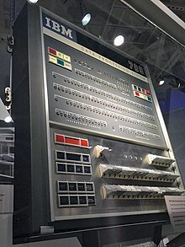
In simple embedded systems and early computers,
processes directly access memory –
“Address 1234” corresponds to a particular byte stored in a particular part of physical memory.
For example, the IBM 709 had to read and write directly to tape with no level of abstraction

Slide 3
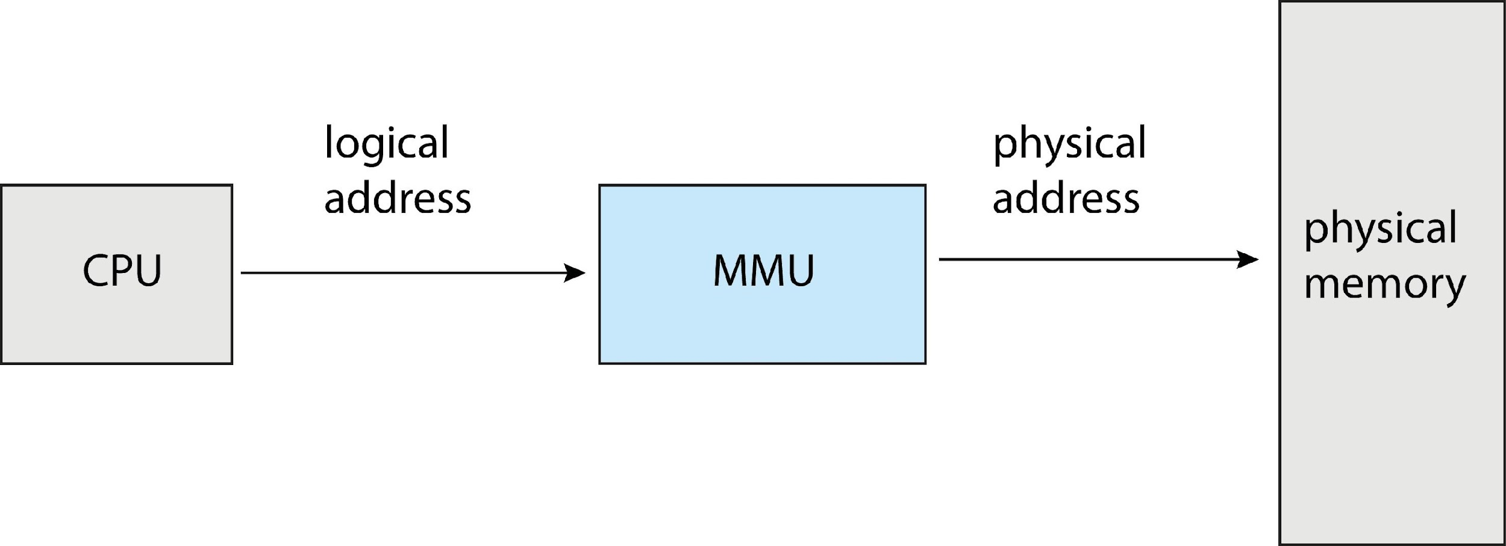
Overall Picture in Modern architectures
Address translation (Memory Management Unit)

Slide 4

The modern process of translating memory
A process makes a memory request
The circuit first checks the Translation Lookaside Buffer (TLB) if the address page is cached into memory. It skips to the reading from/writing to phase if found otherwise the request goes to the MMU.
The Memory Management Unit (MMU) performs the address translation.
If the translation succeeds, the page gets pulled from RAM – conceptually the entire page isn’t loaded up.
The result is cached in the TLB.
The CPU performs the operation by either reading from the physical address or writing to the address.

Slide 5
Address translation
Imagine we had a large table for every possible address where we will store the real i.e. physical address.
Each physical address will need 4 bytes–to hold the 32-bits.
Naturally, this scheme would require 16 billion bytes to store all of the entries.
It should be painfully obvious that our lookup scheme would consume all of the memory that we could buy for our 4GB machine.
The solution is to chunk memory into small regions called ‘pages’ and ‘frames’ and use a lookup table for each page.
The Memory Management Unit(MMU)
is part of the CPU,
it converts a virtual memory address into a physical address.
consider a 32-bit machine, meaning pointers are 32-bits.
They can address 2^32 different locations
or 4GB of memory where one address is one byte.

Slide 6
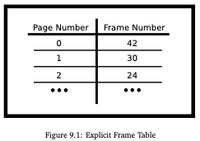
Terminology
a frame or sometimes called a ‘page frame’ is a block of physical memory or RAM – Random Access Memory.
A frame is the same number of bytes as a virtual page or 4KiB on our machine.
A page is a block of virtual memory.
A typical block size on Linux is 4KiB
or 2^12 addresses,
one can find examples of larger blocks

Slide 7
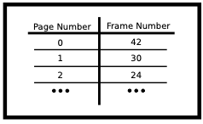
Page table
32-bit computers
2^32 address/2^12(address/page) = 2^20 pages.
64-bit computer
2^64 address/2^12(address/page) = 2^52 pages =~ 10^15
To access a particular byte in a frame, an MMU goes from the start of the frame and adds the offset

Slide 8
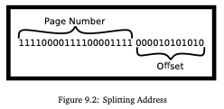
We will assume that a 32-bit machine has 4KiB pages
2^20 pages, so first 20 bits is the page number,
The rest is the offset (address-index in the page)

Slide 9
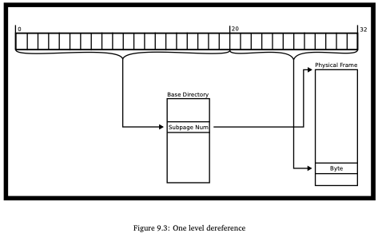
One level dereferencing

Slide 10
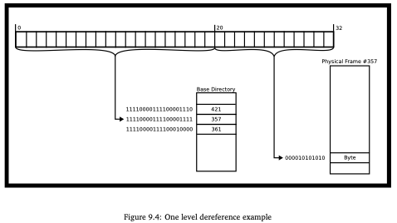
Example: What is the page table size?

Slide 11
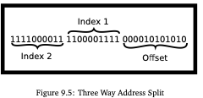
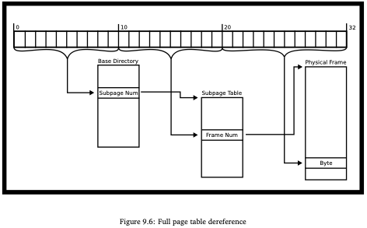
Multi level page tables to reduce page-table size
Multi-level page tables only allocates page-table space in proportion to the amount of address space you are using;

Slide 12
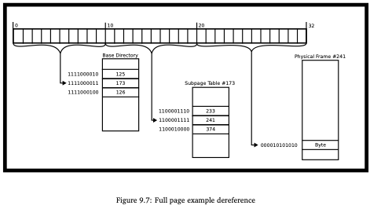
Page tables are slow.
For a single page table, our machine is now twice as slow! Two memory accesses are required.
For a two-level page table, memory access is now three times as slow – three memory accesses are required.

Slide 13
Page Table Disadvantages & TLB (translation lookaside table)
To overcome this overhead, the MMU includes an associative cache of recently-used virtual-page-to-frame lookups. This cache is called the TLB (“translation lookaside buffer”).
Every time a virtual address needs to be translated into a physical memory location, the TLB is queried in parallel to the page table.
For most memory accesses of most programs, there is a significant chance that the TLB has cached the results. However, if a program has inadequate cache coherence, the address will be missing in the TLB, meaning the MMU must use the much slower page table translation.

Slide 14
MMU algorithm
here is a sort of pseudocode associated with the MMU. We will assume that this is for a single-level page table.
1. Receive address
2. Try to translate address according to the programmed scheme
3. If the translation fails, report an invalid address
4. Otherwise,
(a) If the TLB contains the physical memory, get the physical frame from the TLB and perform the read and write.
(b) If the page exists in memory, check if the process has permissions to perform the operation on the page meaning the process has access to the page, and it is reading from the page/writing to a page that it has permission to do so.
If so then do the dereference provide the address, cache the results in the TLB
Otherwise, trigger a hardware interrupt. The kernel will most likely send a SIGSEGV or a Segmentation Violation.
(c) If the page doesn’t exist in memory, generate an Interrupt.
The kernel could realize that this page could either be not allocated or on disk. If it fits the mapping, allocate the page and try the operation again.
Otherwise, this is invalid access and the kernel will most likely send a SIGSEGV to the process.
How would you alter this for a multi-level page table?

Slide 15
Bits on pages
2. The execution bit defines whether bytes in a page can be executed as CPU instructions.
Processors may merge these bits into one and deem a page either writable or executable.
This bit is useful because it prevents stack overflow or code injection attacks when writing user data into the heap or the stack because those are not read-only and thus not executable.
3. The dirty bit allows for performance optimization.
And many others
This is heavily dependent on the chipset. We will include some bits that have historically been popular in chipsets.
The read-only bit marks the page as read-only. Attempts to write to the page will cause a page fault.

Slide 16
Page faults
2. Major If the mapping to the page is exclusively on disk.
The operating system will swap the page into memory and swap another page out.
If this happens frequently enough, your program is said to thrash the MMU.
3. Invalid When a program tries to write to a non-writable memory address or read to a non-readable memory address.
The MMU generates an invalid fault and the OS will usually generate a SIGSEGV meaning segmentation violation meaning that the program wrote outside the segment that it could write to.
A page fault may happen when a process accesses an address in a frame missing in memory. There are three types of Page Faults
1. Minor If there is no mapping yet for the page, but it is a valid address.
This could be memory asked for by sbrk(2) but not written to yet
meaning that the operating system can wait for the first write before allocating space
– if it was read from, the operating system could short circuit the operation to read 0.
The OS simply makes the page, loads it into memory, and moves on.

Slide 17
What does this have to do with IPC?
Before, we knew that processes had isolation.
you didn’t know how that isolation mapped.
you may not know how you can break this isolation.
Interprocess communication requires “breaking” this isolation in some way.

Slide 18
What does this have to do with IPC?
To break a memory level isolation,
we have two avenues.
One is to ask the kernel to provide some kind of interface.
The other is to ask the kernel to map two pages of memory to the same virtual memory area and handle all the synchronization yourself.

Slide 19
Mmap: map or unmap files or devices into memory
mmap is a trick of virtual memory
instead of mapping a page to a frame, it can be mapped to a file on disk,
and the frame can be shared among processes.
We can use mmap to read from a file on disk efficiently or sync changes to the file.
One of the big optimizations is a file may be “lazily” allocated to memory.
char buf[100] = "merhaba";
int len = strlen(buf);
int offset = 0;
int fd = open("hello.txt", O_WRONLY);
lseek(fd, offset, SEEK_SET);
write(fd, buf, len);
close(fd);

Slide 20
/*with mmap*/
#include <sys/mman.h>
#include <fcntl.h> #include <unistd.h> #include <stdio.h>
int main(){
int len = 100;
off_t offset = 0;
int fd2 = open("hello.txt", O_RDWR);
char *addr = mmap(NULL, len, PROT_WRITE,
MAP_SHARED, fd2, offset);
addr[0] = 'A';
addr[1] = 'B';
printf("%.100s\n", addr);
munmap(addr, len);
close(fd2);
}
/*standard file I/O*/
char buf[100] = "merhaba";
int len = strlen(buf);
int offset = 0;
int fd = open("hello.txt", O_WRONLY);
lseek(fd, offset, SEEK_SET);
write(fd, buf, len);
close(fd);

Slide 21
mmap
The kernel sees that the program wants to mmap the file into memory, so it will reserve some space in your address space that is the length of the file.
That means when the program writes to addr[0] that it writes to the first byte of the file.
The kernel can do some optimizations too. Instead of loading the whole file into memory, it may only load pages at a time.
A program may only access 3 or 4 pages making loading the entire file a waste of time. Page faults are so powerful because let the operating system take control of when a file is used.
int len = 100;
off_t offset = 0;
int fd2 = open("hello.txt", O_RDWR);
char *addr = mmap(NULL, len, PROT_WRITE,
MAP_SHARED, fd2, offset);
addr[0] = 'A';
addr[1] = 'B';
printf("%.100s\n", addr);
munmap(addr, len);
close(fd2);

Slide 22
mmap
prot determines the type of access
PROT_READ This means the process can read the memory. The underlying file descriptor, in this case, must be opened with read privileges.
PROT_WRITE This means the process can write to the memory.
PROT_EXEC This means the process can execute this piece of memory.
PROT_NONE This means the process can’t do anything with the mapping. This could be useful if you implement guard pages in terms of security.
flags determines how to handle the changed data
MAP_SHARED This mapping will be synchronized to the underlying file object. The file descriptor must’ve been opened with write permissions in this case.
MAP_PRIVATE This mapping will only be visible to the process itself. Useful to not thrash the operating system.
#include <sys/mman.h>
void *mmap(void *addr, size_t length,
int prot, int flags,
int fd, off_t offset);
addr,
Start address of new mapping
If NULL, kernel chooses
length,
Length of the mapping in bytes starting from offset

Slide 23
#include <sys/mman.h>
void *mmap(void addr[.length],
size_t length, int prot, int flags,
int fd, off_t offset);
Fd is a file descriptor can be
fd = open("hello.txt", O_WRONLY);
fd = shm_open(shmpath, O_CREAT | O_EXCL | O_RDWR, 0600);
https://man7.org/linux/man-pages/man7/shm_overview.7.html

Slide 24
General guidance for memory-mapped files
Get a file descriptor with a call to the open or shm_open function.
Map the object using the file descriptor with a call to the mmap function.
Unmap the object with a call to the munmap function.
Close the object with a call to the close function.
Remove the shared-memory object with a call to the shm_unlink function or optionally remove a memory-mapped file with a call to the unlink function.
Taken from https://www3.physnet.uni-hamburg.de/physnet/Tru64-Unix/HTML/APS33DTE/DOCU_004.HTM

Slide 25
Walkthrough of the example code in the man pages
Our command-line utility will take a file, offset, and length to print.
To obtain file info in linux
#include <sys/stat.h>
struct stat {
dev_t st_dev; /* ID of device containing file */
ino_t st_ino; /* Inode number */
mode_t st_mode; /* File type and mode */
nlink_t st_nlink; /* Number of hard links */
uid_t st_uid; /* User ID of owner */
gid_t st_gid; /* Group ID of owner */
dev_t st_rdev; /* Device ID (if special file) */
off_t st_size; /* Total size, in bytes */
blksize_t st_blksize; /* Block size for filesystem I/O */
blkcnt_t st_blocks; /* Number of 512B blocks allocated */
...
int fd = open("hello.txt", O_RDWR);
struct stat sb;
fstat(fd, &sb);
/*
sb.st_size is the file size
*/

Slide 26
mmap doesn’t let the program pass in any value as an offset, it needs to be a multiple of the page size.
off_t offset = atoi(argv[2]);
pa_offset = offset & ~(sysconf(_SC_PAGE_SIZE) - 1);
/* offset for mmap() must be page aligned, it rounds down the value:
example
Let Page size be 4096
~(4096-1) = ~4095 = -4096 that is 1111...1000000000000 which zeros the lowest bits of offset*/

Slide 27
char * addr = mmap(NULL,
length + offset - page_offset,
PROT_READ, MAP_PRIVATE,
fd, page_offset);
1. NULL, this tells mmap we don’t need any particular address to start from
2. length + offset - page_offset, mmaps the “rest” of the file into memory (starting from offset)
3. PROT_READ, we want to read the file
4. MAP_PRIVATE, tell the OS, we don’t want to share our mapping
5. fd, object descriptor that we refer to
6. pa_offset, the page aligned offset to start from

Slide 28
write(1, addr + offset - page_offset, length);
munmap(addr, length + offset - pa_offset);
close(fd);
we can interact with the address as if it were a normal buffer.
After, we have to unmap the file and close the file descriptor to make sure other system resources are freed.

Slide 29
Using mmap to communicate across processes
/*allocate some space with mmap*
int size = 100 * sizeof(int);
void *addr = mmap(0, size, PROT_READ | PROT_WRITE,
MAP_SHARED | MAP_ANONYMOUS, -1, 0);
int *shared = addr;
MAP_ANONYMOUS :
The mapping is not backed by any file;
its contents are initialized to zero.
The fd argument is ignored; however, some implementations require fd to be -1
The offset argument should be zero.

Slide 30
pid_t child = fork();
if (child > 0){
shared[0] = 10;
shared[1] = 20;
}
else{
sleep(1); // Check the synchronization chapter for a better way
printf("%d\n", shared[1] + shared[0]);
}
munmap(addr, size);
return 0;
Since sleep is not a mutex there is no assurance that the values are communicated (use semaphores)
Note that each process should call munmap when done using the piece of memory.

Slide 31
MMAP for Two different process (not parent-child)
Use shm_open function.
int
shm_open(const char *name, int oflag, ...);
The shared memory object referenced by name is opened for reading and/or writing as specified by the argument oflag and the file descriptor returned to the calling process.
Repeated calls to shm_open
with the same string value for name() will return a file descriptor referring to the same shared memory
object, provided that the object has not been unlinked by a call to shm_unlink().
See man shm_open

Slide 32
Example (from $ man shm_open)
1 process writes data to shared memory, the other one converts it to uppercase
1 need to wait for the data
1 need to wait for the uppercase
struct shmbuf {
sem_t sem1; /* POSIX unnamed semaphore */
sem_t sem2; /* POSIX unnamed semaphore */
size_t cnt; /* Number of bytes used in 'buf' */
char buf[BUF_SIZE]; /* Data being transferred */
};

Slide 33
Create shared memory object
/*pshm_ucase_bounce.c*/
#include <ctype.h>
#include "pshm_ucase.h"
int main(int argc, char *argv[]) {
if (argc != 2) {
fprintf(stderr, "Usage: %s /shm-path\n", argv[0]);
exit(EXIT_FAILURE);
}
char *shmpath = argv[1];
/* Create shared memory object and set its size to the size
of our structure. */
int fd = shm_open(shmpath, O_CREAT | O_EXCL | O_RDWR, S_IRUSR | S_IWUSR);
if (fd == -1) errExit("shm_open");
if (ftruncate(fd, sizeof(struct shmbuf)) == -1) errExit("ftruncate");

Slide 34
Map the object into caller’s address space
/* Map the object into the caller's address space. */
struct shmbuf *shmp =
mmap(NULL, sizeof(*shmp), PROT_READ | PROT_WRITE, MAP_SHARED, fd, 0);
if (shmp == MAP_FAILED) errExit("mmap");

Slide 35
Initialize semaphore and wait
/* Initialize semaphores as process-shared, with value 0. */
if (sem_init(&shmp->sem1, 1, 0) == -1) errExit("sem_init-sem1");
if (sem_init(&shmp->sem2, 1, 0) == -1) errExit("sem_init-sem2");
/* Wait for 'sem1' to be posted by peer before touching shared memory. */
if (sem_wait(&shmp->sem1) == -1) errExit("sem_wait");

Slide 36
Process shared data and post sem2
/* Convert data in shared memory into upper case. */
for (int j = 0; j < shmp->cnt; j++)
shmp->buf[j] = toupper((unsigned char)shmp->buf[j]);
/* Post 'sem2' to tell the peer that it can now
access the modified data in shared memory. */
if (sem_post(&shmp->sem2) == -1) errExit("sem_post");
/* Unlink the shared memory object. Even if the peer process
is still using the object, this is okay. The object will
be removed only after all open references are closed. */
shm_unlink(shmpath);
exit(EXIT_SUCCESS);
}

Slide 37
Sender process: take a string msg and shm-path
/*pshm_ucase_send.c*/
#include <string.h>
#include "pshm_ucase.h"
int main(int argc, char *argv[]) {
if (argc != 3) {
fprintf(stderr, "Usage: %s /shm-path string\n", argv[0]);
exit(EXIT_FAILURE);
}
char *shmpath = argv[1];
char *string = argv[2];
size_t len = strlen(string);
if (len > BUF_SIZE) {
fprintf(stderr, "String is too long\n");
exit(EXIT_FAILURE);
}

Slide 38
open shared object and map it to address space
/* Open the existing shared memory object and map it
into the caller's address space. */
int fd = shm_open(shmpath, O_RDWR, 0);
if (fd == -1) errExit("shm_open");
struct shmbuf *shmp =
mmap(NULL, sizeof(*shmp), PROT_READ | PROT_WRITE, MAP_SHARED, fd, 0);
if (shmp == MAP_FAILED) errExit("mmap");

Slide 39
Copy data into shared memory
/* Copy data into the shared memory object. */
shmp->cnt = len;
memcpy(&shmp->buf, string, len);
/* Tell peer that it can now access shared memory. */
if (sem_post(&shmp->sem1) == -1) errExit("sem_post");

Slide 40
Wait for response
/* Wait until peer says that it has finished accessing
the shared memory. */
if (sem_wait(&shmp->sem2) == -1) errExit("sem_wait");
/* Write modified data in shared memory to standard output. */
write(STDOUT_FILENO, &shmp->buf, len);
write(STDOUT_FILENO, "\n", 1);
exit(EXIT_SUCCESS);
}

Slide 41
Sharing anonymous memory is an efficient form of inter-process communication because there is no copying, system call, or disk-access overhead - the two processes share the same physical frame of main memory.
On the other hand, shared memory, like in a multithreading context, creates room for data races. Processes that share writable memory might need to use synchronization primitives like mutexes to prevent these from happening.

Slide 42
Pipes
You’ve seen the virtual memory way of IPC, but there are more standard versions of IPC that are provided by the kernel. One of the big utilities is POSIX pipes. A pipe simply takes in a stream of bytes and spits out a sequence of bytes.
pipes were invented to take the output of one program and feed it to the input of another program though they have other uses today
$ ls -l | more

Slide 43
$ ls -1 | cut -d'.' -f1 | sort | uniq | tee dirents
What does the following code do?
First, it lists the current directory.
The -1 means that it outputs one entry per line.
The cut command then takes everything before the first period.
sort sorts all the input lines,
uniq makes sure all the lines are unique.
Finally, tee outputs the contents to the file dirents and the terminal for your perusal.
The important part is that bash creates 5 separate processes and connects their standard outs/stdins with pipes the trail looks something like this.

Slide 44
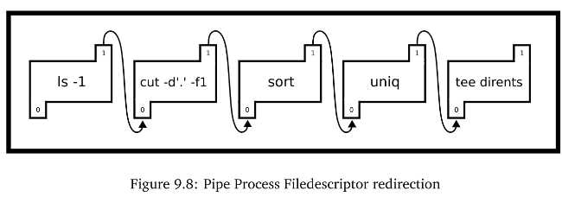
The numbers in the pipes are the file descriptors for each process and the arrow represents the redirect or where the output of the pipe is going.

Slide 45
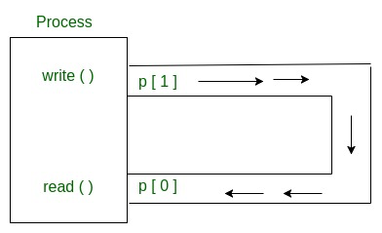
POSIX pipes: pipe() system call
A POSIX pipe is almost like its real counterpart - a program can stuff bytes down one end and they will appear at the other end in the same order.
Unlike real pipes, however, the flow is always in the same direction, one file descriptor is used for reading and the other for writing.
The pipe system call is used to create a pipe. These file descriptors can be used with read and write.
A common method of using pipes is to create the pipe before forking to communicate with a child process
#include <unistd.h>
int pipe(int p[2]);
https://www.geeksforgeeks.org/pipe-system-call/

Slide 46
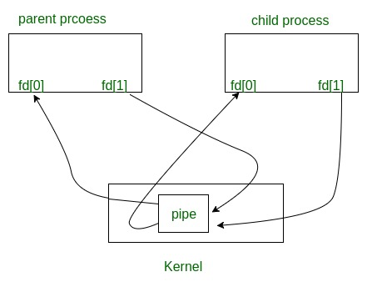
int fd[2];
pipe(fd);
/*fd[0] is set up for reading,
fd[1] is set up for writing*/
pid_t child = fork();
file descriptors remain open across child and parent processes.
If we call fork after creating a pipe, then the parent and child can communicate via the pipe.
https://www.geeksforgeeks.org/pipe-system-call/

Slide 47
#include <unistd.h>
#include <stdio.h>
int main(){
int filedes[2];
pipe(filedes);
pid_t child = fork();
if (child > 0){ /* I must be the parent */
char buffer[80];
int bytesread = read(filedes[0], buffer, sizeof(buffer));
// do something with the bytes read
}else{
write(filedes[1], "done", 4);
}
}

Slide 48
infinite loop!
int main(){
int fd[2]; pipe(fd);
printf("Reading from %d, writing to %d\n", fd[0], fd[1]);
if (fork() > 0){/*the parent */
write(fd[1], "Hi Child!", 9);
wait(NULL);
}else{
char buf; int bytesread;
// read one byte at a time.
while ((bytesread = read(fd[0], &buf, 1)) > 0){
putchar(buf);
}
}
return 0;
}
When there are no characters, child blocks and waits more character because the pipe is not closed.

Slide 49
A simple solution
while ((bytesread = read(fd[0], &buf, 1)) > 0){
putchar(buf);
/* a solution */
if (buf == '!') break; /* End of message */
}

Slide 50
Or close all writers
if (p > 0){
write(fd[1], "Hi Child!", 9);
close(fd[1]);
wait(NULL);
}
else{
char buf;
int bytesread;
close(fd[1]);
while ((bytesread = read(fd[0], &buf, 1)) > 0){
putchar(buf);
}

Slide 51
If there is no readers!
If all file descriptors referring to the read end of a pipe have been closed,
then a write(2) will cause a SIGPIPE signal to be generated for the calling process.

Slide 52
int main(){
signal(SIGPIPE, no_one_listening);
int filedes[2];
pipe(filedes);
pid_t child = fork();
if (child > 0){/* the parent.*/
/* Close the listening end of the pipe */
close(filedes[0]);
}else{
close(filedes[0]);
/* Child writes messages to the pipe */
write(filedes[1], "One", 3);
write(1, "Done\n", 5);
}
return 0;
}
#include <stdio.h>
#include <stdio.h>
#include <unistd.h>
#include <signal.h>
void no_one_listening(int signal){
write(1, "No one is listening!\n", 21);
}

Slide 53
Duplicate file descriptor
int dup( int oldfd );
int dup2( int oldfd, int newfd );
The dup() system call creates a copy of the file descriptor
int pipe2(int pipefd[2], int flags);
flags
O_CLOEXEC
Sets the close-on-exec flag on the two new file descriptors.
$ ls -1 | cut -f1 -d.
This command takes the output of ls -1 which lists the content of the current directory on one line each and pipes it to cut.
Cut take a delimiter, in this case, a dot, and a field position, in our case 1, and outputs per line the nth field by each delimiter.
At a high level, this grabs the file names without the extension of our current directory.

Slide 54
#define _GNU_SOURCE
#include <stdio.h>
#include <fcntl.h>
#include <unistd.h>
#include <stdlib.h>
int main(){
int pipe_fds[2];
pipe(pipe_fds);
fcntl(pipe_fds[0], F_SETFL, O_NONBLOCK);
/* Call with the O_CLOEXEC flag to prevent any commands from blocking in Linux, pipe2(pipe_fds, O_CLOEXEC);*/
/*Remember for pipe_fds,
the program read then write
(reading is 0 and writing is 1)*/
if (!fork()){/* Child */
/* Make the stdout of the process,
the write end */
dup2(pipe_fds[1], 1);
/* Exec! Don’t forget the cast*/
execlp("ls", "ls", "-1", (char *)NULL);
exit(-1);
}
/*parent: the stdin of the process is
the read end */
dup2(pipe_fds[0], 0);
execlp("cut", "cut", "-f1", "-d.", (char *)NULL);
exit(-1);
return 0;
}

Slide 55
pipes with standard file functions(scanf, printf)
#include <unistd.h>
#include <stdlib.h>
#include <stdio.h>
int main() {
int fh[2];
pipe(fh);
FILE *reader = fdopen(fh[0], "r");
FILE *writer = fdopen(fh[1], "w");
pid_t p = fork();
if (p > 0) {
int score;
fscanf(reader, "Score %d", &score);
printf("The child says the score is %d\n", score);
} else {
fprintf(writer, "Score %d", 10 + 10);
fflush(writer);
}
return 0;
}

Slide 56
Named pipes
See man mkfifo
#include <sys/types.h>
#include <sys/stat.h>
int mkfifo(const char *pathname, mode_t mode);

